Slide 1
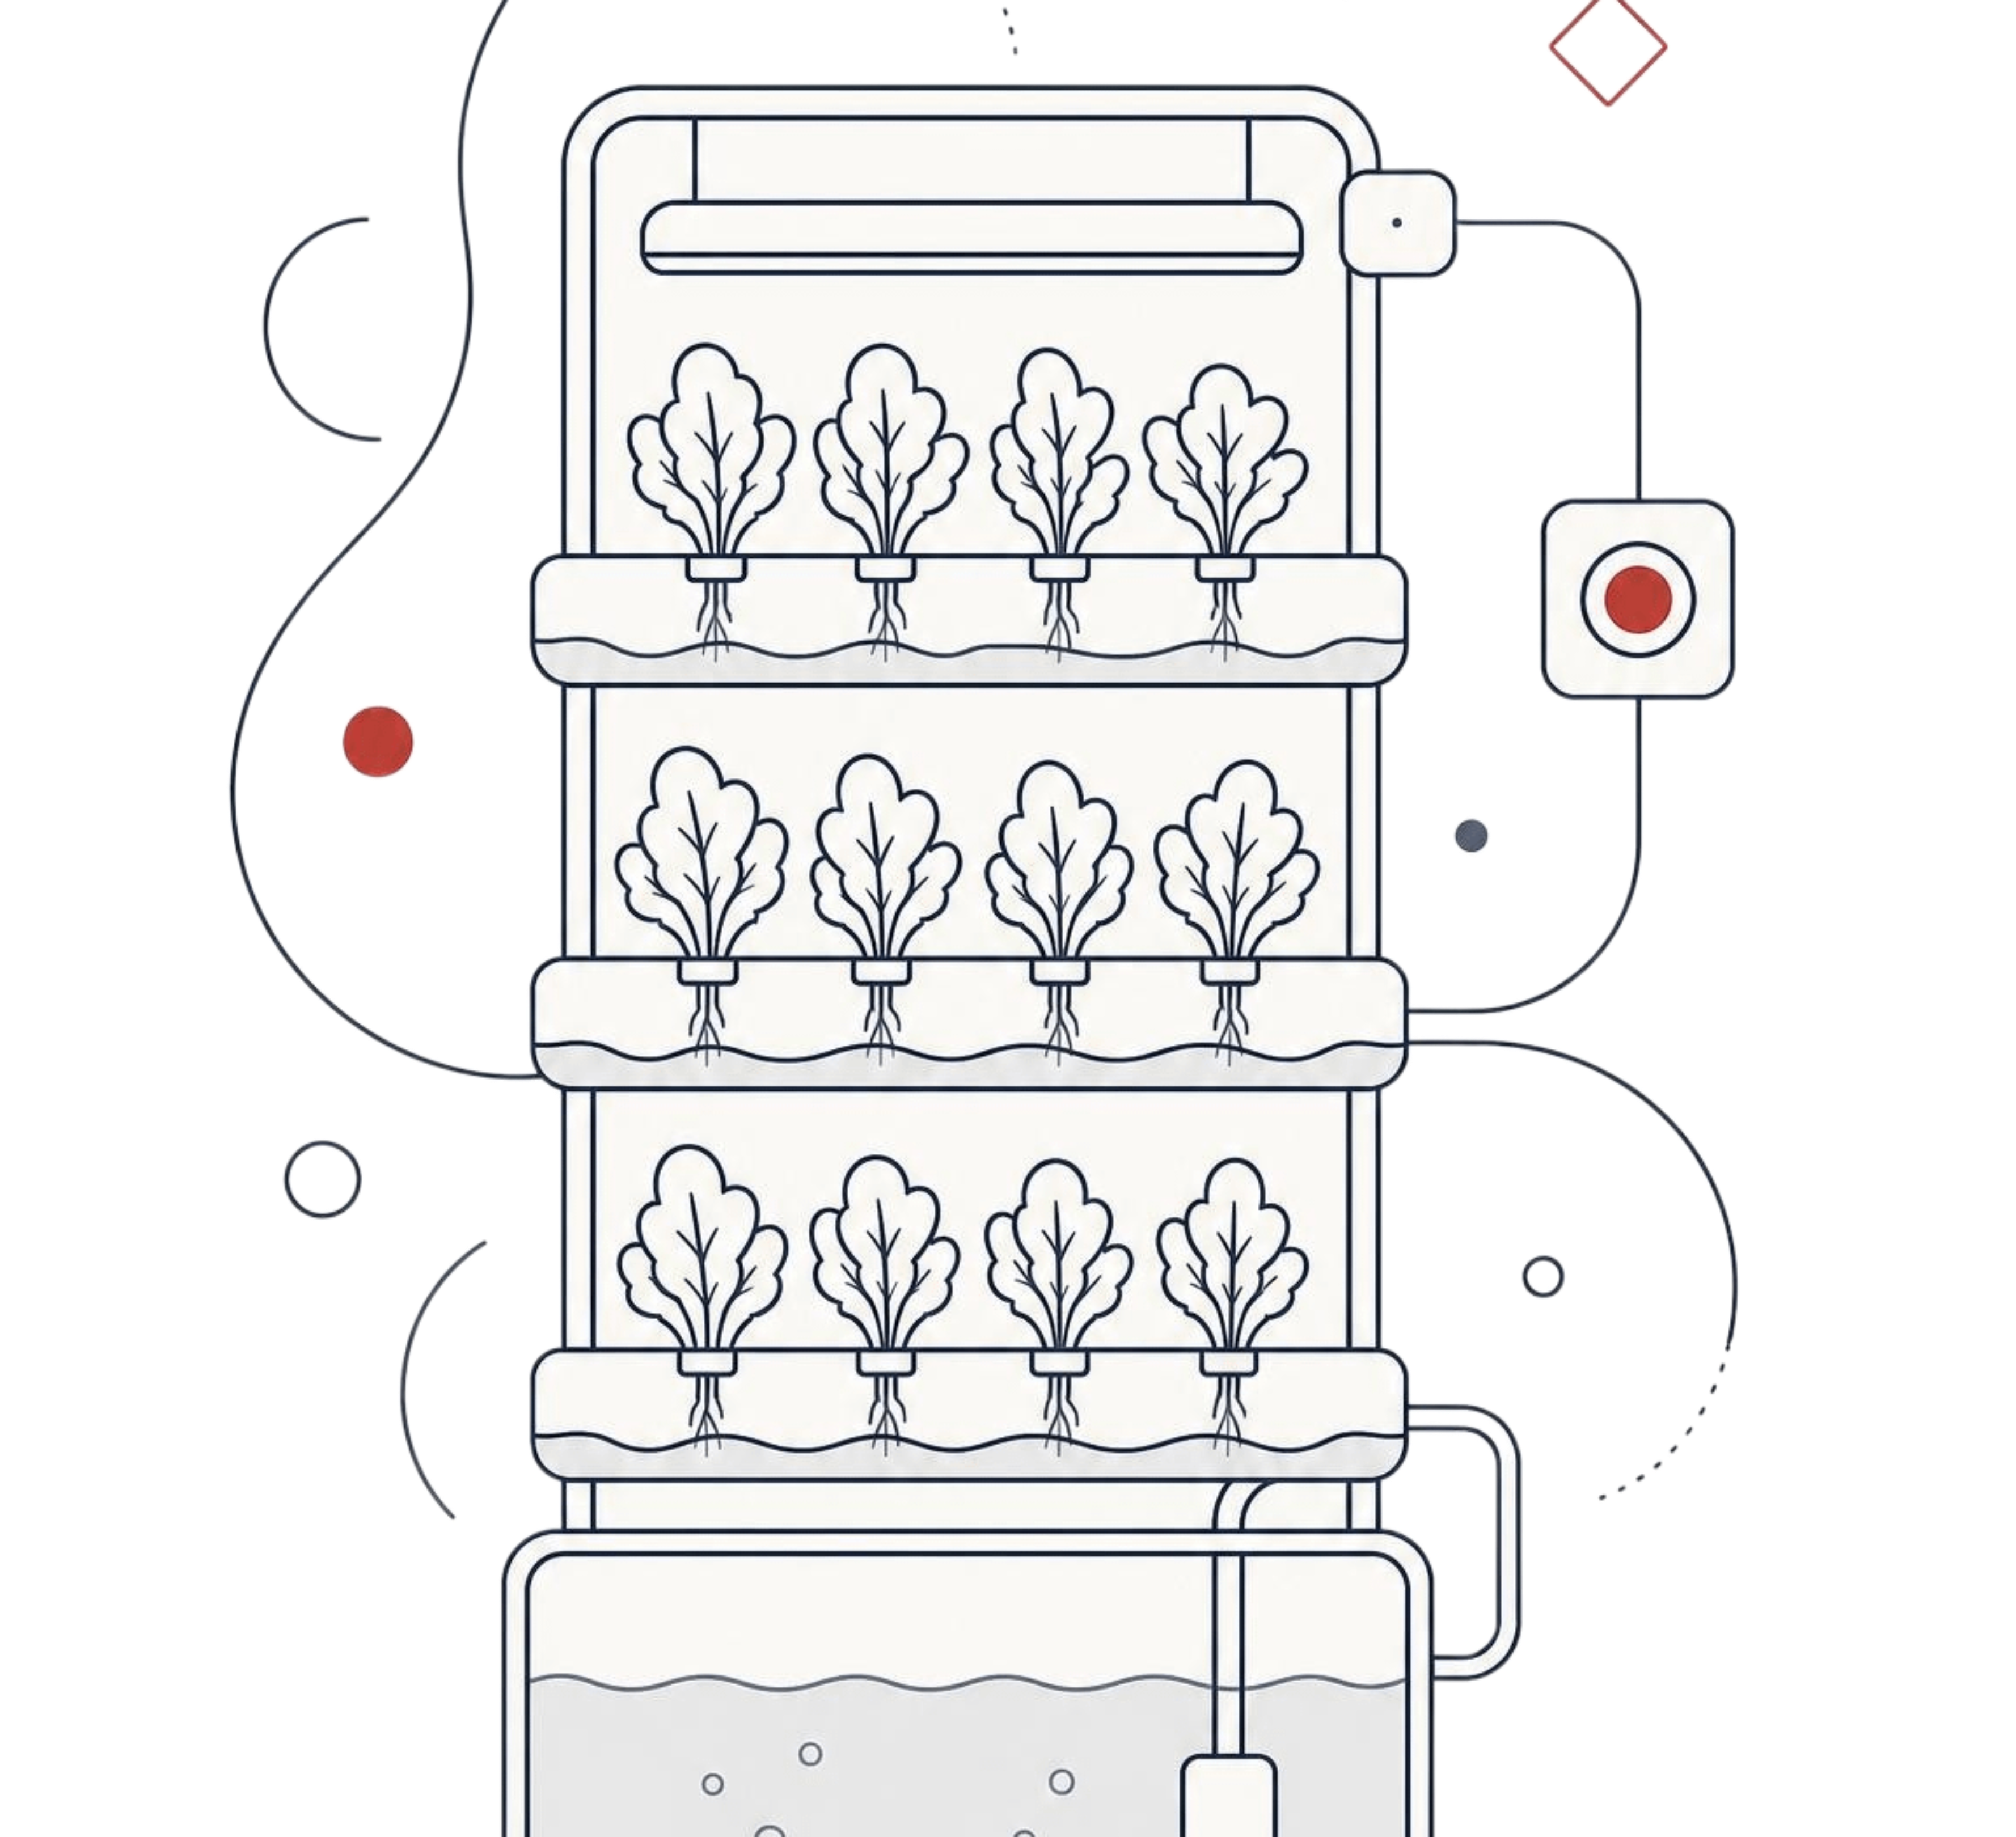
B.TECH CSE · FINAL YEAR PROJECT
HYGROW
SMART AI-POWERED IOT HYDROPONICS SYSTEM
Inderprastha Engineering College, Ghaziabad
Session 2026–27

Slide 2
A PLANT CAN BE UNHEALTHY BEFORE IT LOOKS UNHEALTHY
Visible symptoms — leaf color, wilting, stunted growth — are a late signal. Plant problems often take days or weeks to become visually obvious; by then the plant may already have suffered significant stress or growth loss. The real gap: farmers need to know something is wrong before it becomes visible.
pH gradually drifts out of range
Farmer receives an early alert
Corrective action is taken
Plant never reaches visible stress

Slide 3
Stage | What HyGrow does
Monitor: | live farm sensor data — temperature, humidity, pH, TDS, water level, light
Analyse: | historical trends beyond the current reading
Predict: | AI plant health and growth/harvest prediction
Act: | smart alerts trigger corrective action early
Sell: | marketplace connects farmers directly to customers
ONE CONNECTED LOOP, NOT ISOLATED SENSORS
HyGrow connects the entire hydroponic workflow instead of treating farm sensors as a standalone system.

Slide 4
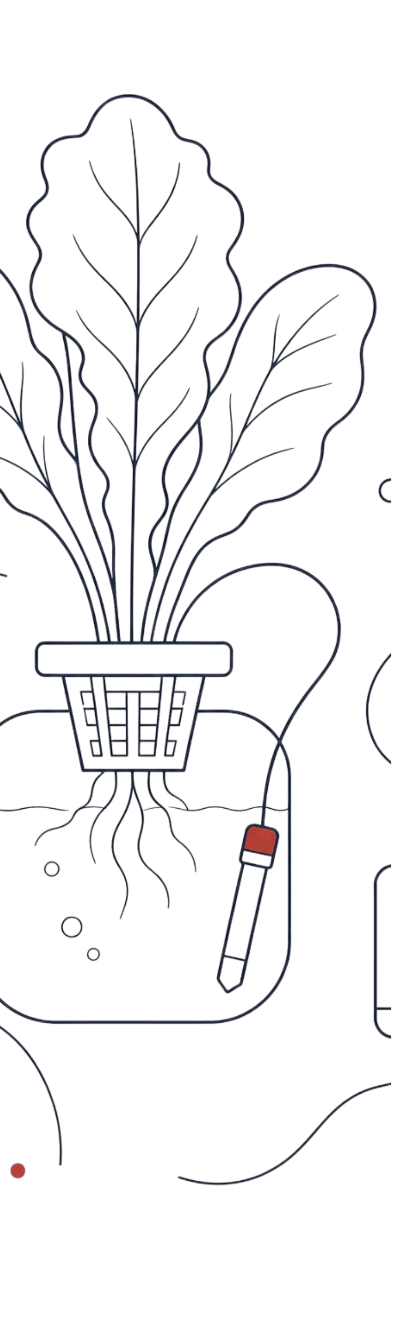
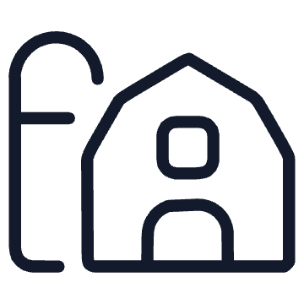

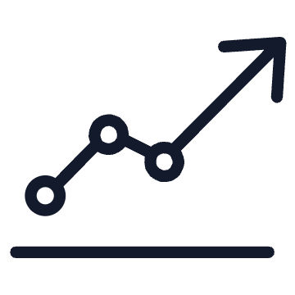


CORE FEATURES
Live monitoring
Smart alerts
Historical analytics
Real-time temperature, humidity, pH, TDS, water level, light, and system status.
Warnings when values leave safe ranges.
Track trends over time.
AI disease detection
Growth prediction
Farm management
Estimate growth status and harvest timing from sensor data.
Manage inventory and connect farmers with customers.
Leaf-photo health results and recommendations.

Slide 5



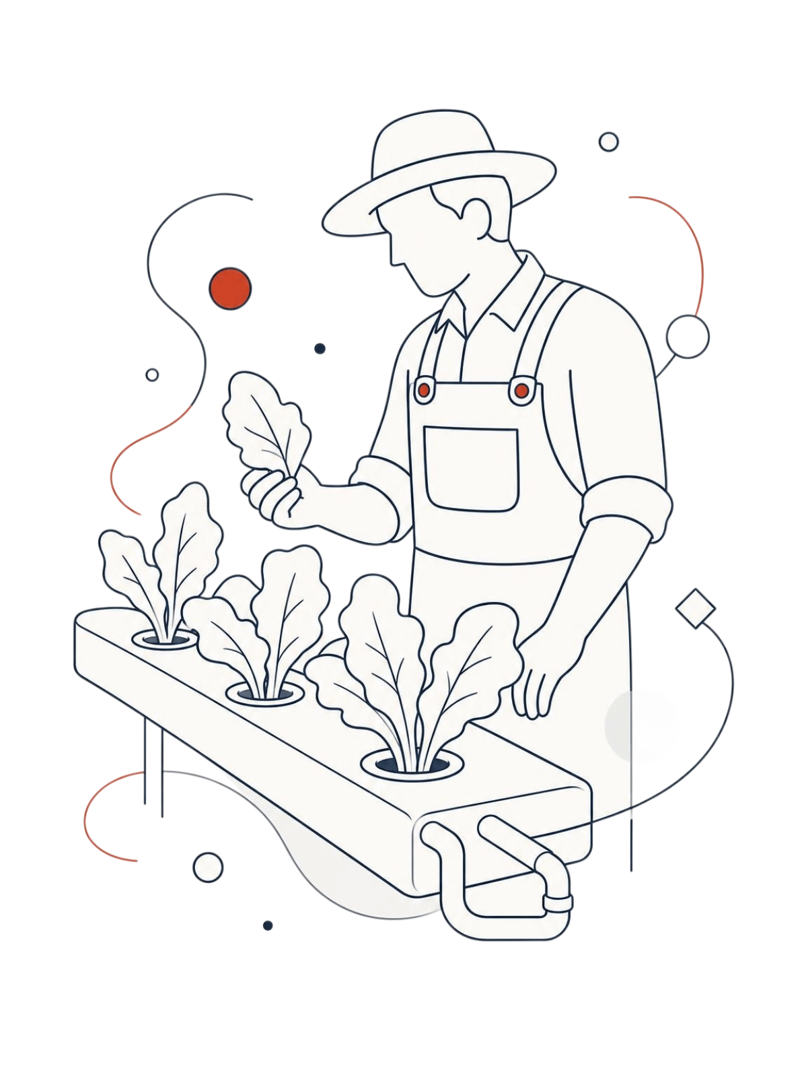
BUILT FOR THREE
KINDS OF USERS
Farmer
Customer
Monitors farm conditions, receives alerts, uses AI tools, manages inventory, and sells produce.
Admin
Browses produce, places orders, tracks orders, views order history.
Platform and order oversight with broader access.

Slide 6
PROGRESS SO FAR,
AND WHAT’S NEXT
FIRST TERM
NEXT PHASE
Foundations built
What's ahead
Problem identification & research, requirement analysis, system architecture, IoT monitoring foundation, app development with authentication & roles, dashboard & analytics, AI disease detection, growth prediction, inventory & marketplace, order management
Better integration between modules, testing & debugging, improving prediction capabilities, system optimization, end-to-end and field validation, final documentation & deployment

Slide 7
TEAM · Ekta Jain, Vaibhav Sharma, Prithvi Singh, Samarth Sharma
THANK
YOU
GUIDE · Prof. Dr. Vijai Singh
HyGrow brings farm condition, plant intelligence, and market access into one connected platform.
INSTITUTION · Inderprastha Engineering College, Ghaziabad
PROGRAM · B.Tech CSE, Session 2026–27

